Slide 1


TIME SERIES FORECASTING PROJECT
Armaan Dhanda, Georgy Jacob, Nithin Srivatsa

Slide 2
Motivation
We chose the Superstore Dataset since it is well-documented, well-studied and is a business focused dataset. Our main priority was working on a dataset that had business applicability.
Our goal is to use the lessons and models we learnt in the Time Series Forecasting class to make predictions for the Superstore dataset and improve our understanding of sales forecasting.

Slide 3
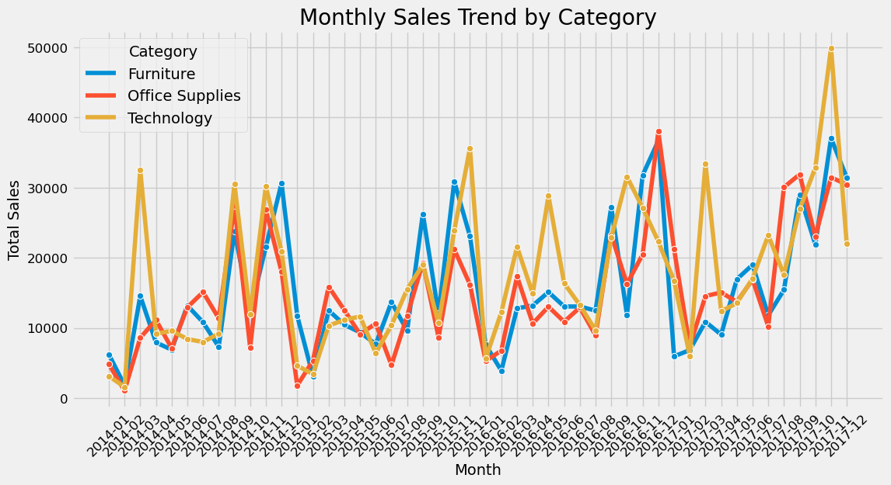
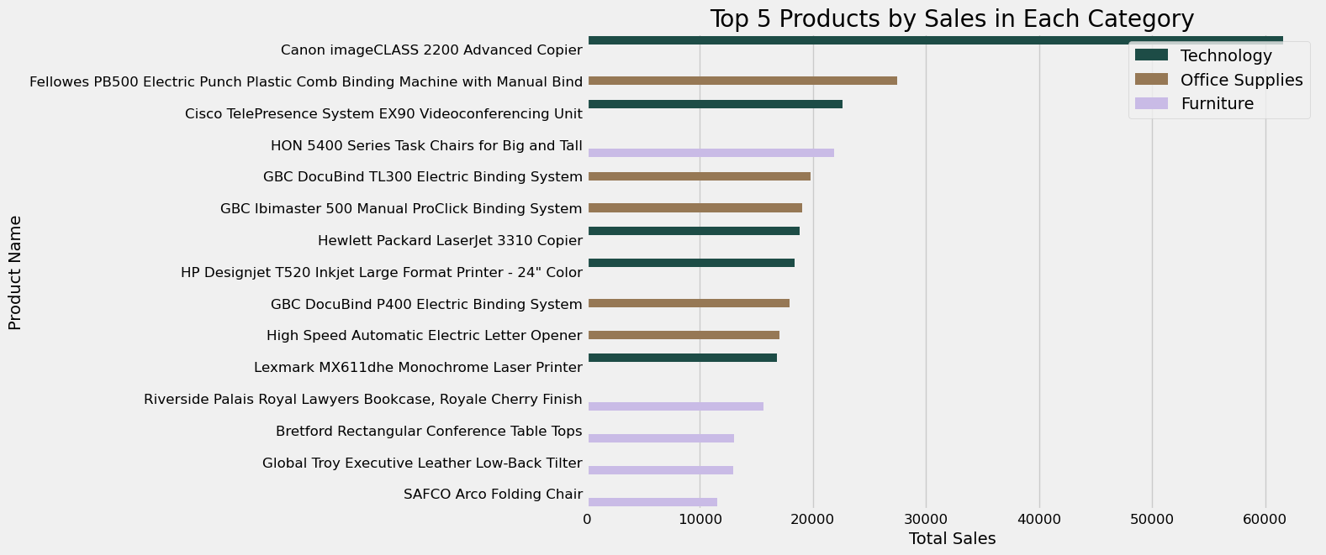
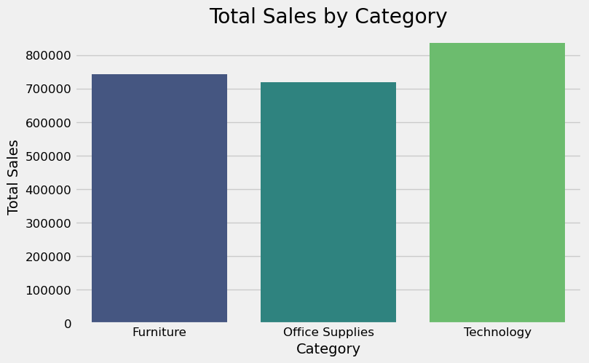
Exploratory Data Analysis
The Dataset contains 3 categories: Furniture, Office Supplies and Technology.
It starts on Jan 1 2014, and ends on Dec 31, 2017.

Slide 4
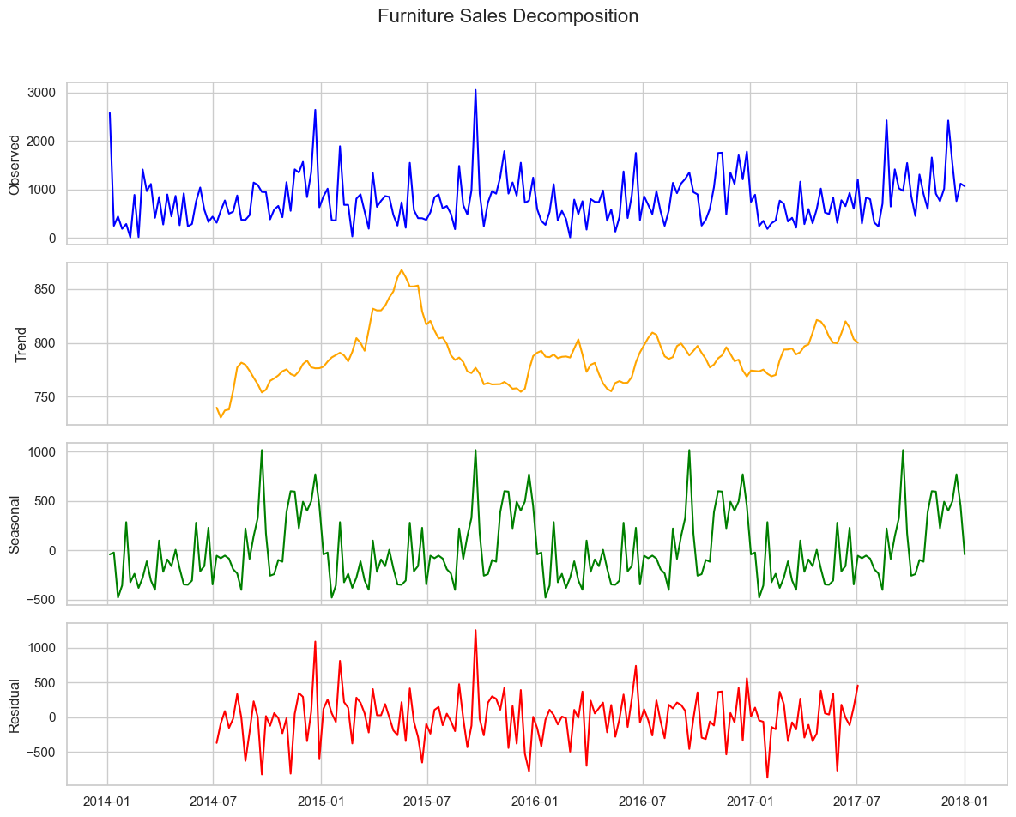
Seasonality – Furniture

Slide 5
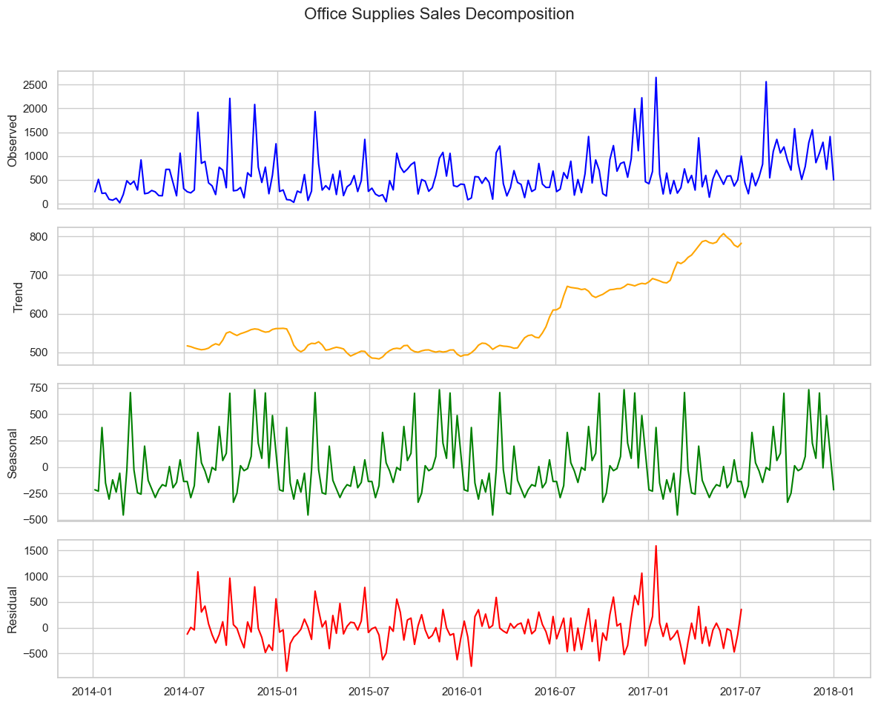
Seasonality – Office Supplies

Slide 6
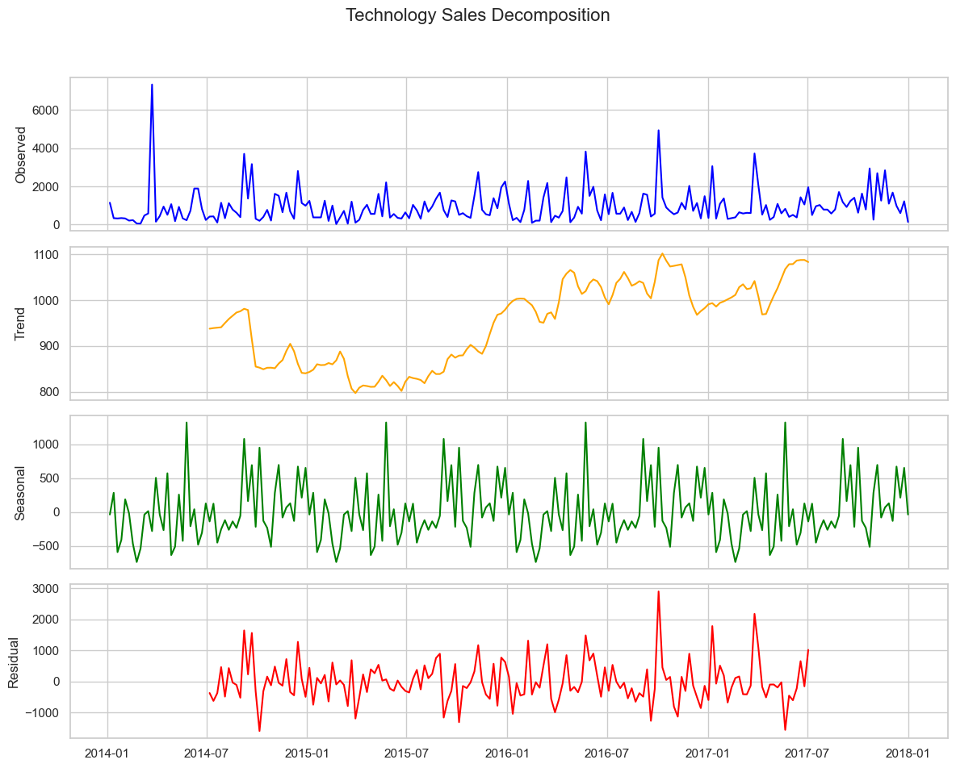
Seasonality – Technology

Slide 7
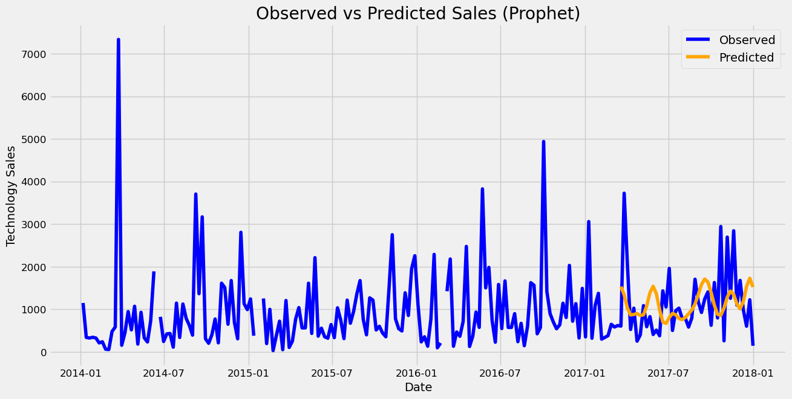
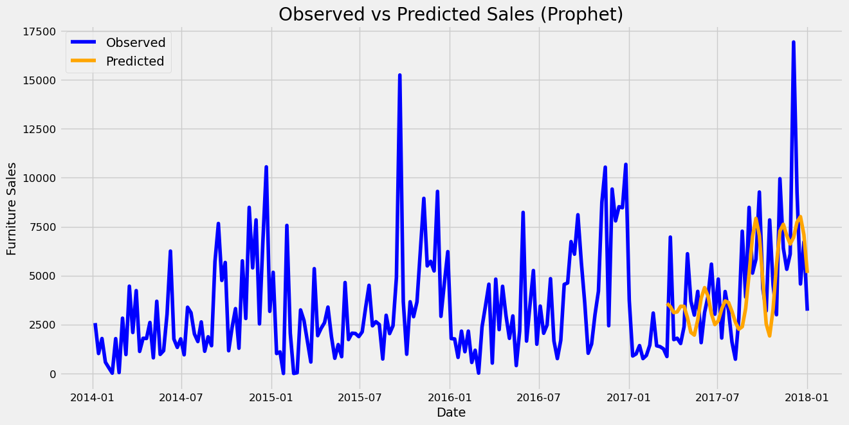
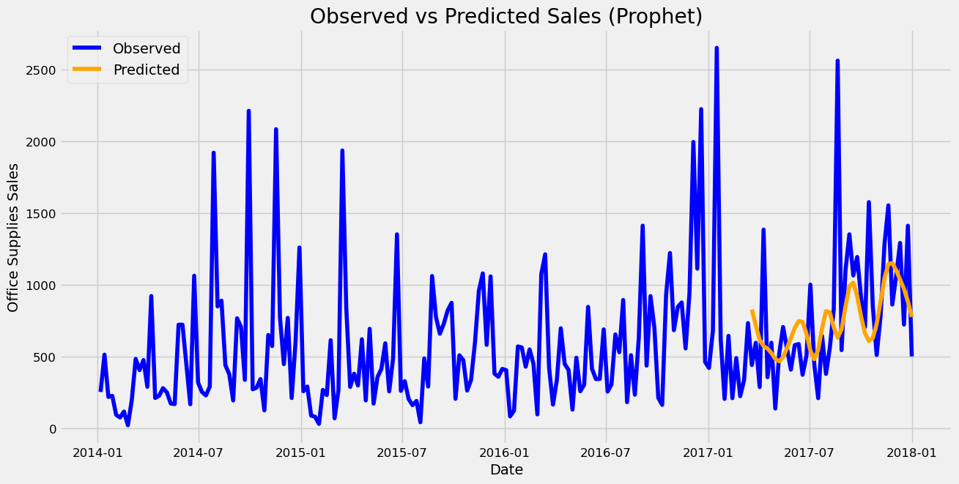
Prophet Model
Furniture Test RMSE - 264.449
Office Supplies Test RMSE - 432.57
Technology Test RMSE – 822.67

Slide 8
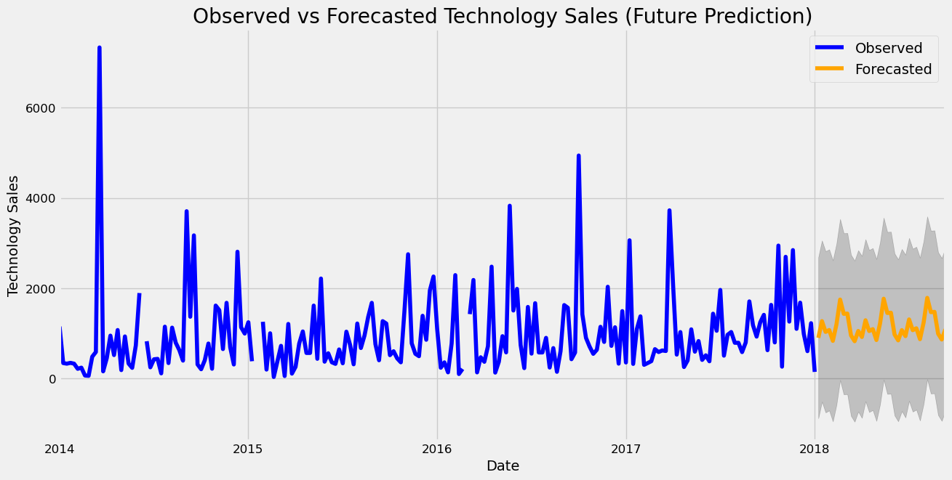
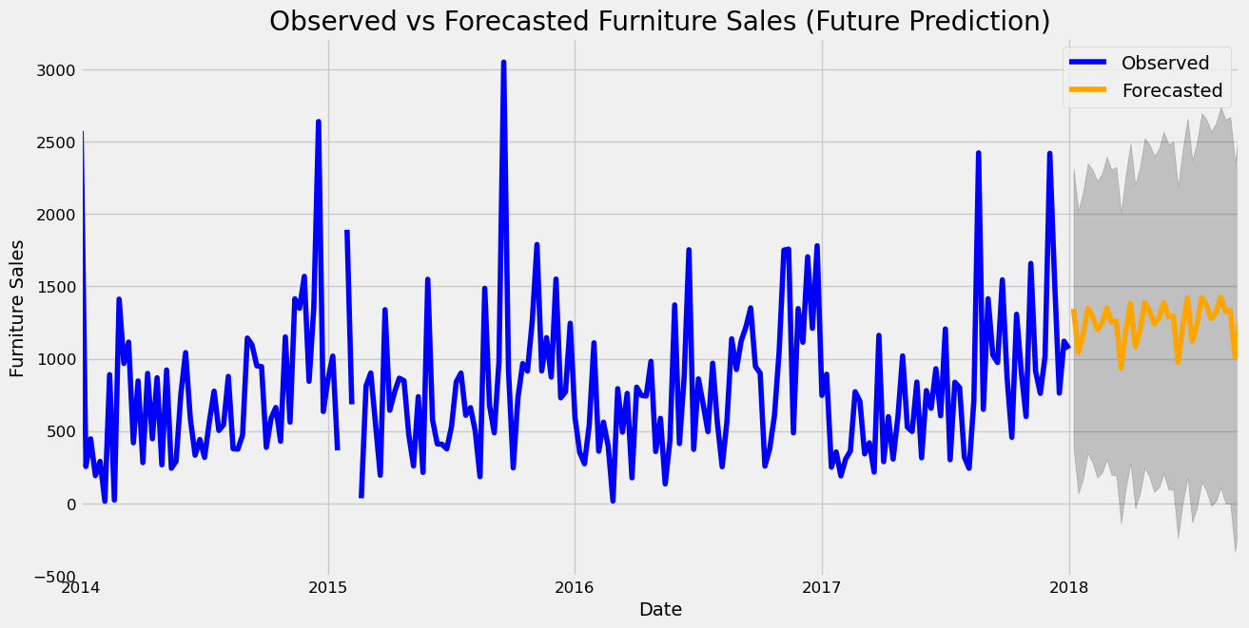
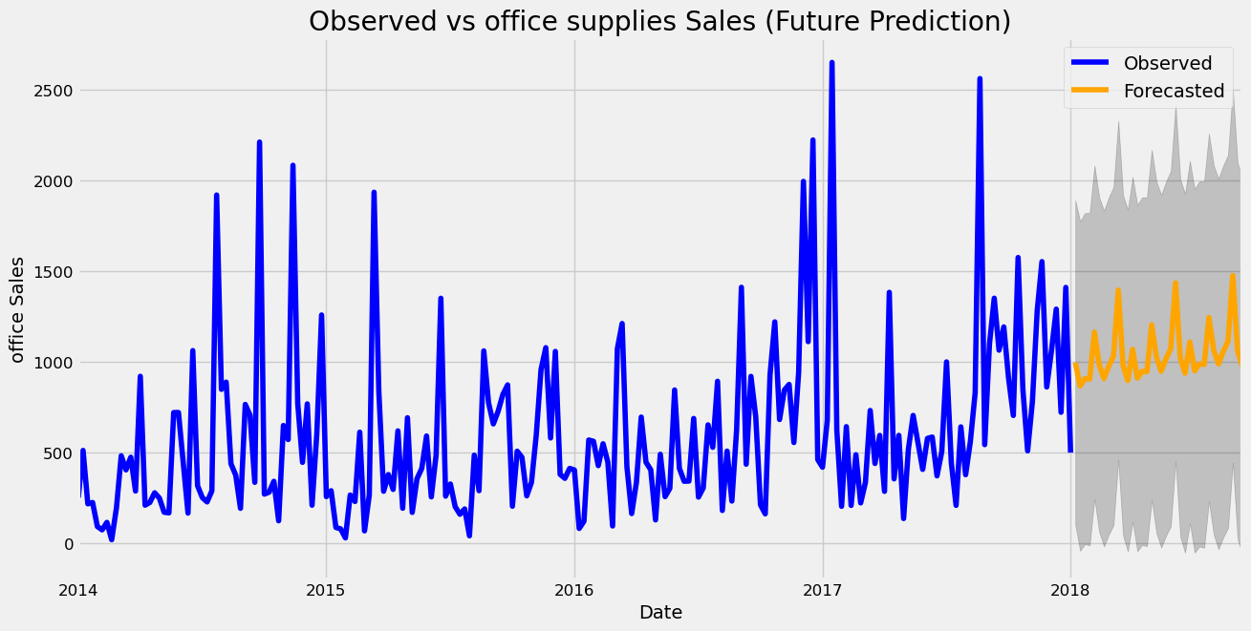
SARIMA Model
SARIMA Furniture Test RMSE – 598.95
SARIMA Office Supplies Test RMSE – 428.04
SARIMA Technology Test RMSE- 1003.17

Slide 9
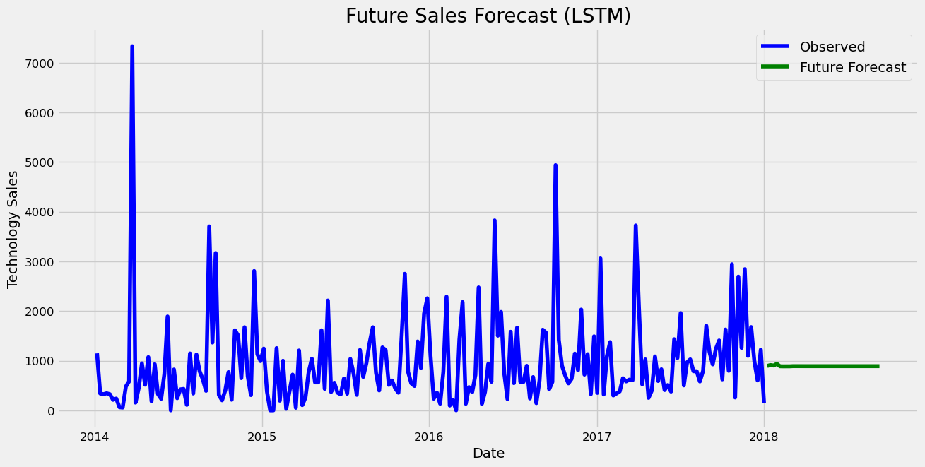
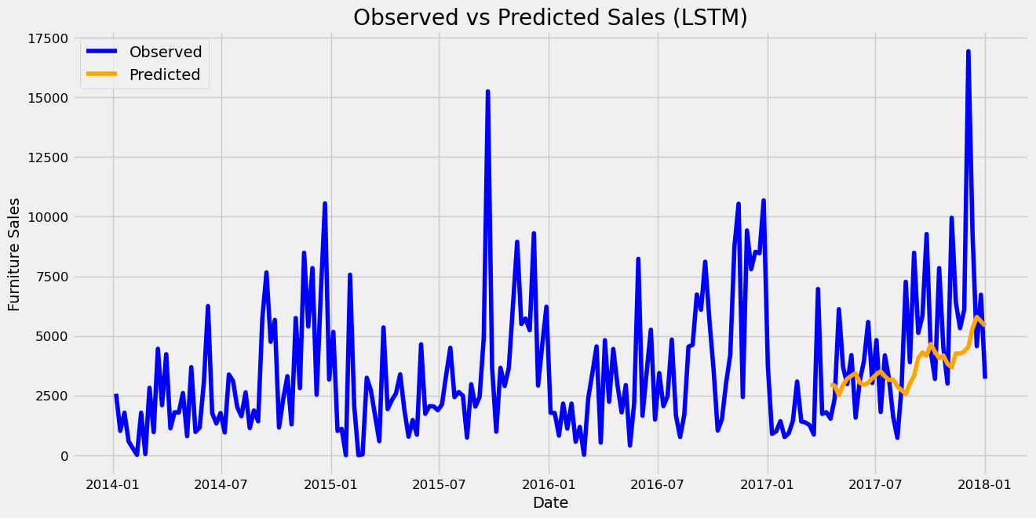
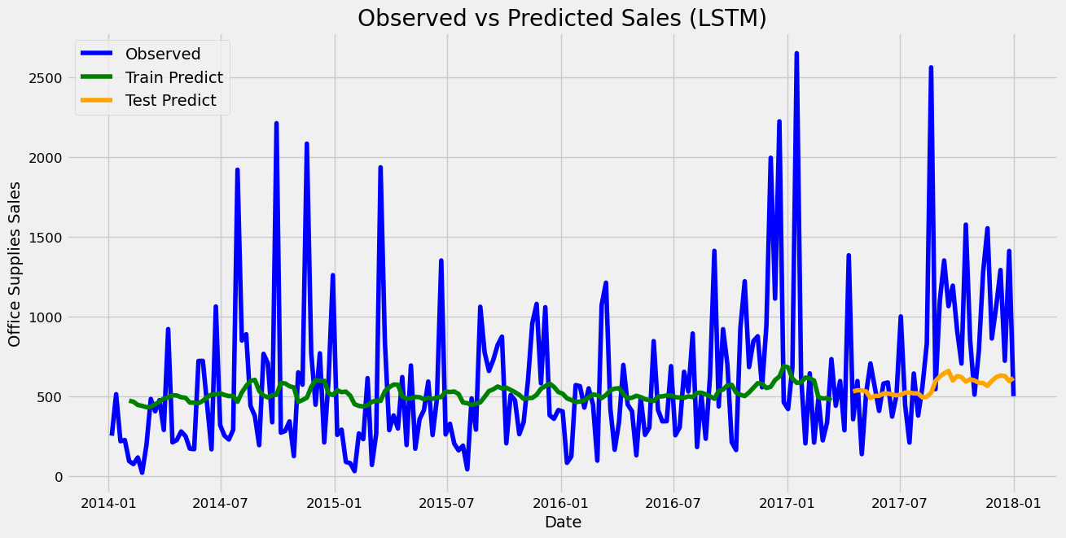
LSTM Model
Furniture Test RMSE – 3014.69
Office Supplies Test RMSE – 495.77
Technology Test RMSE – 716.81

Slide 10
Conclusion
For Furniture, Prophet is the best ranked model.
For Office Supplies, SARIMA is the best performing model, although Prophet is quite close in this aspect.
For Technology, LSTM is the best performing model.
Overall, Prophet can be considered the best model since it is consistently first or second ranked.
Final insights:
This dataset appears to be quite volatile, and forecasting revenue is always difficult!
Prophet has the lowest RMSE and the most stable predictions. Even when it’s wrong, it’s not wrong by much, and that’s quite important.
The LSTM model was quite effective as well, but was seriously off (along with SARIMA) when it came to Furniture, which gave the edge to Prophet.

